Slide 1
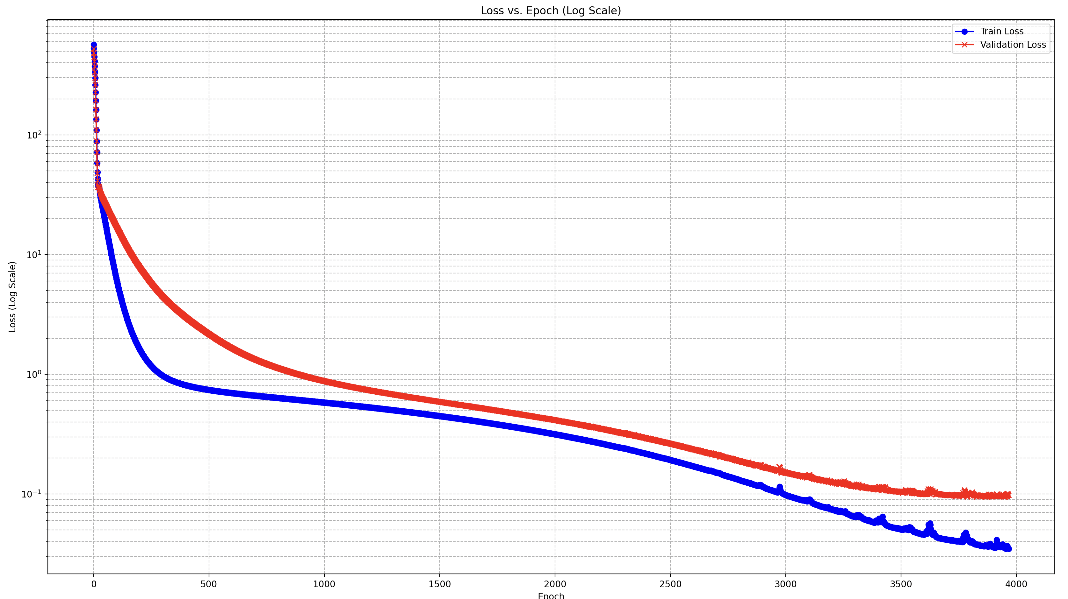
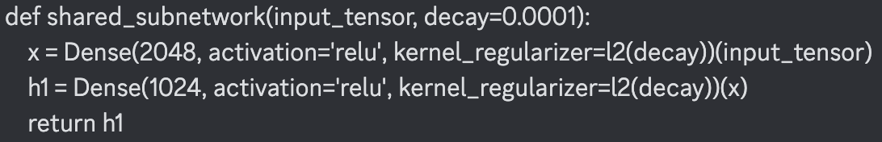
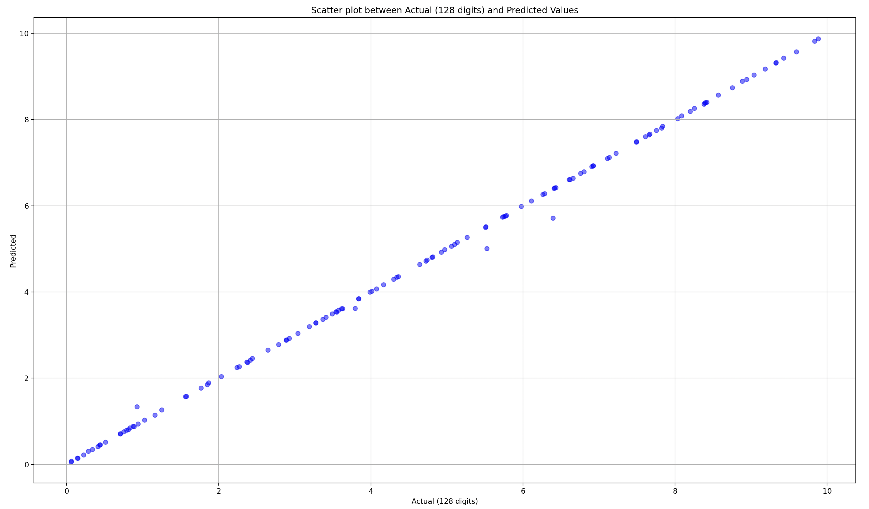
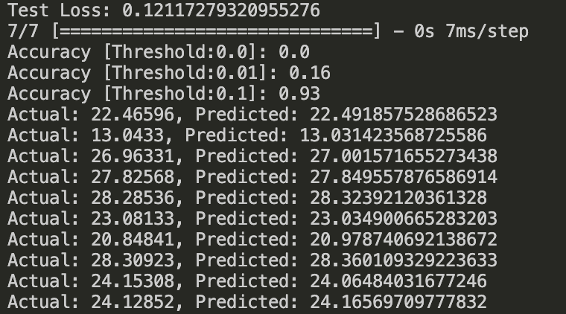

Slide 2
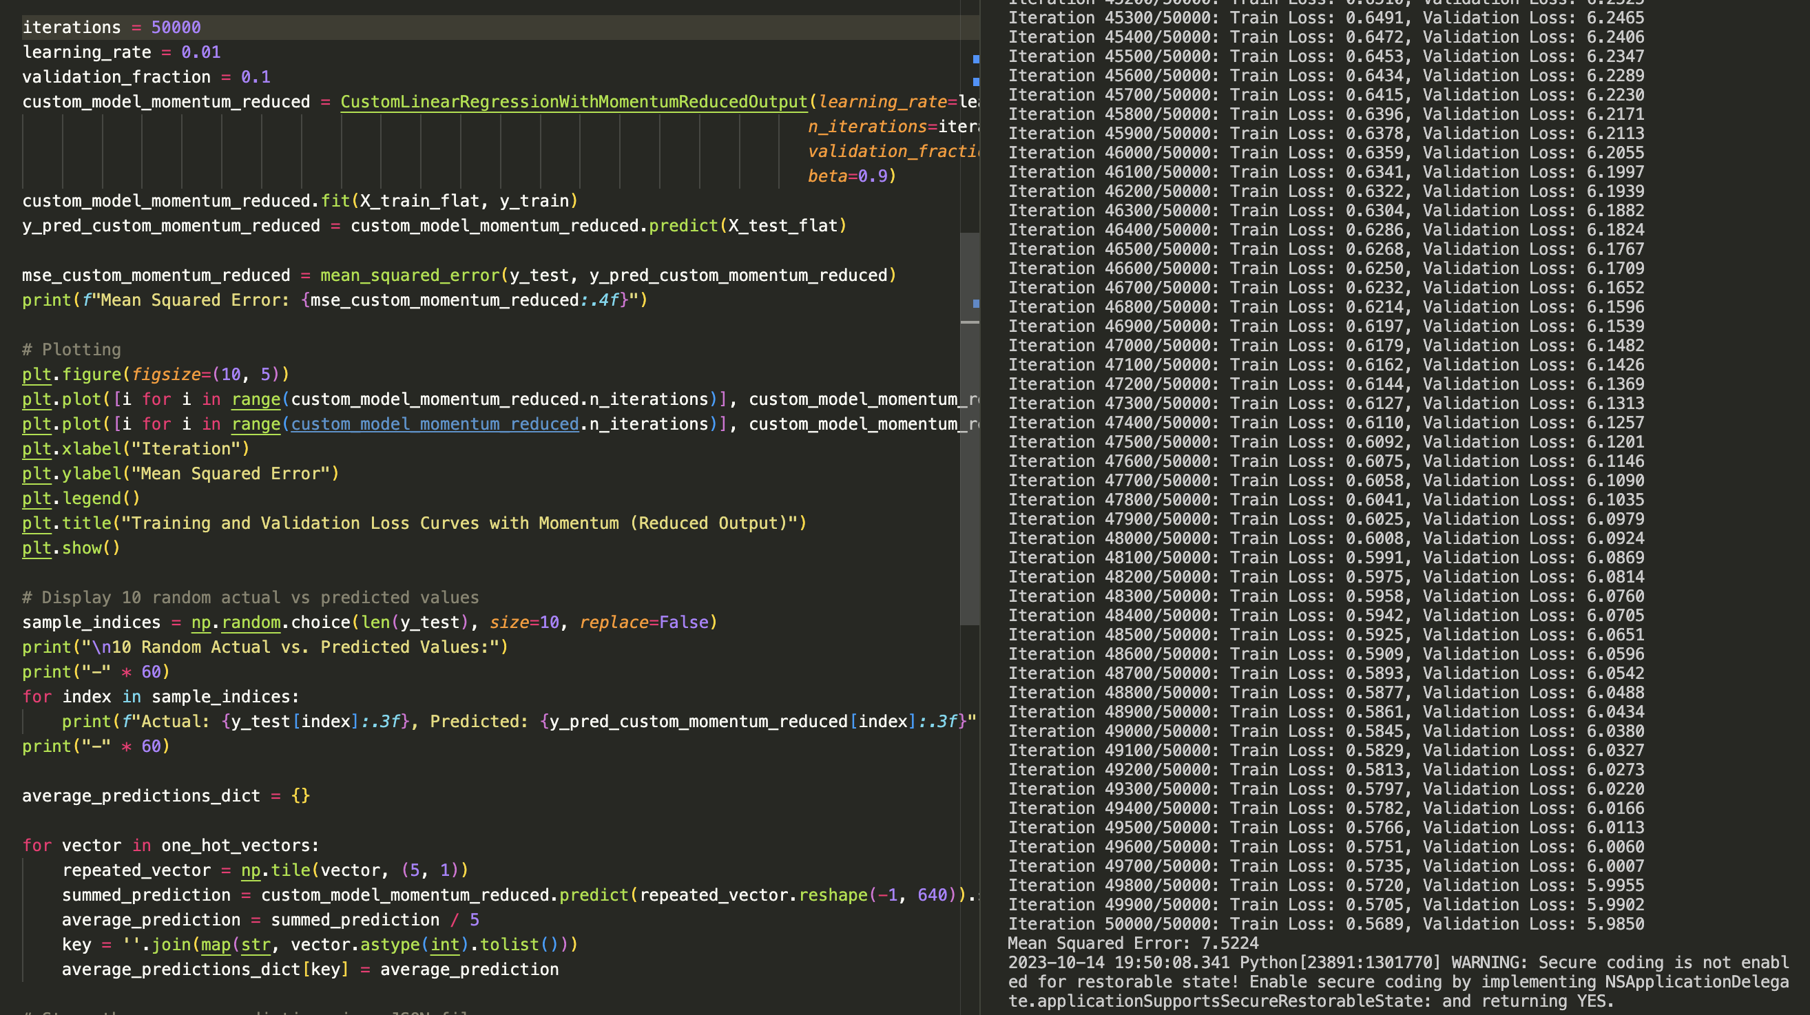
Custom Linear Regression

Slide 3
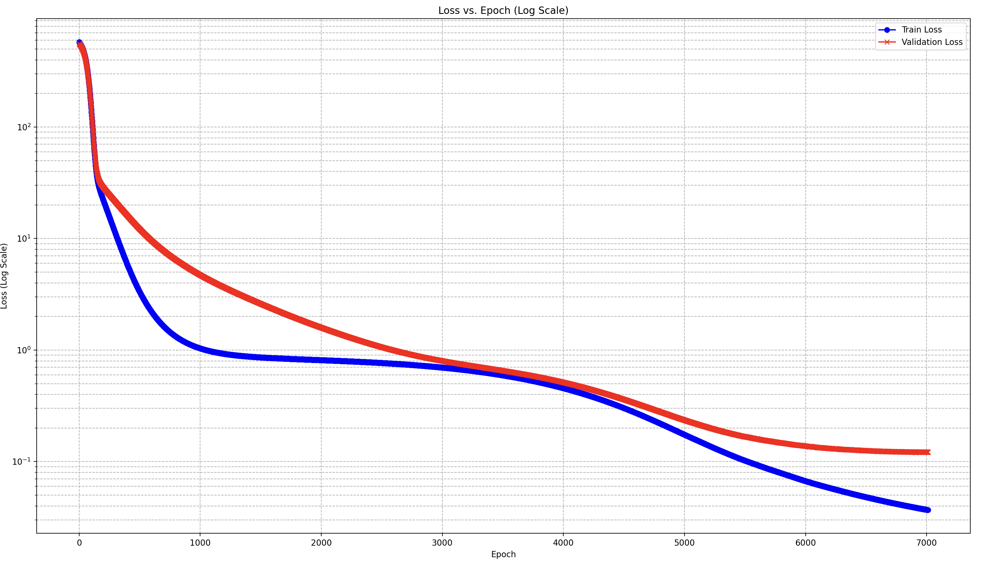
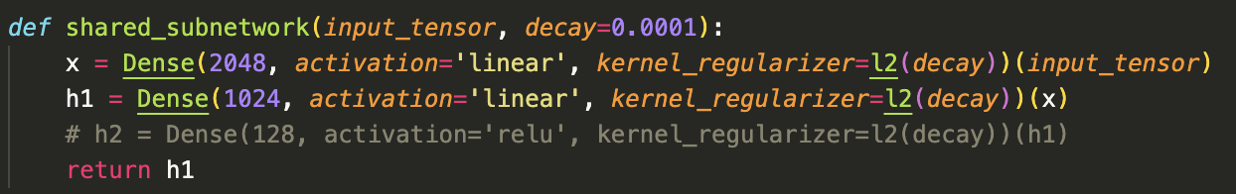
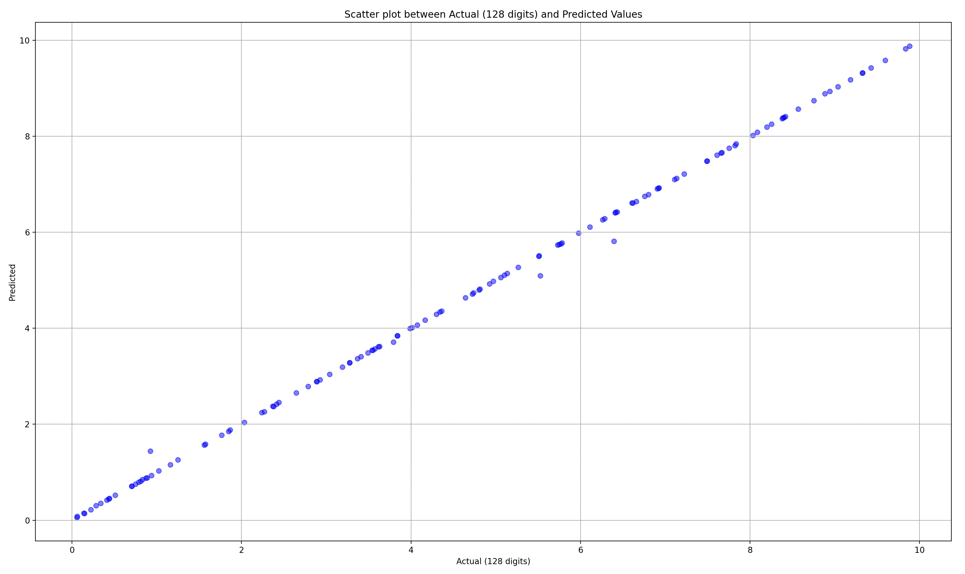
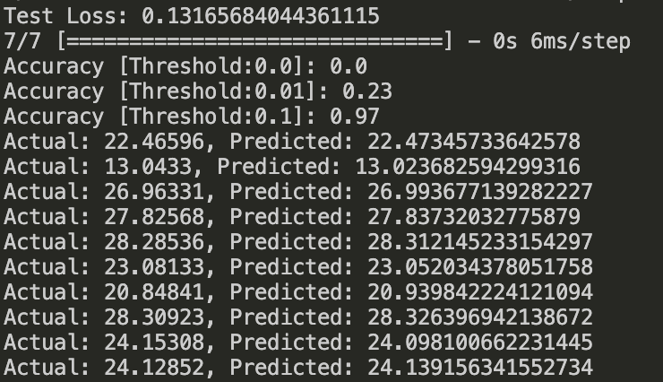
(linear, linear)

Slide 4
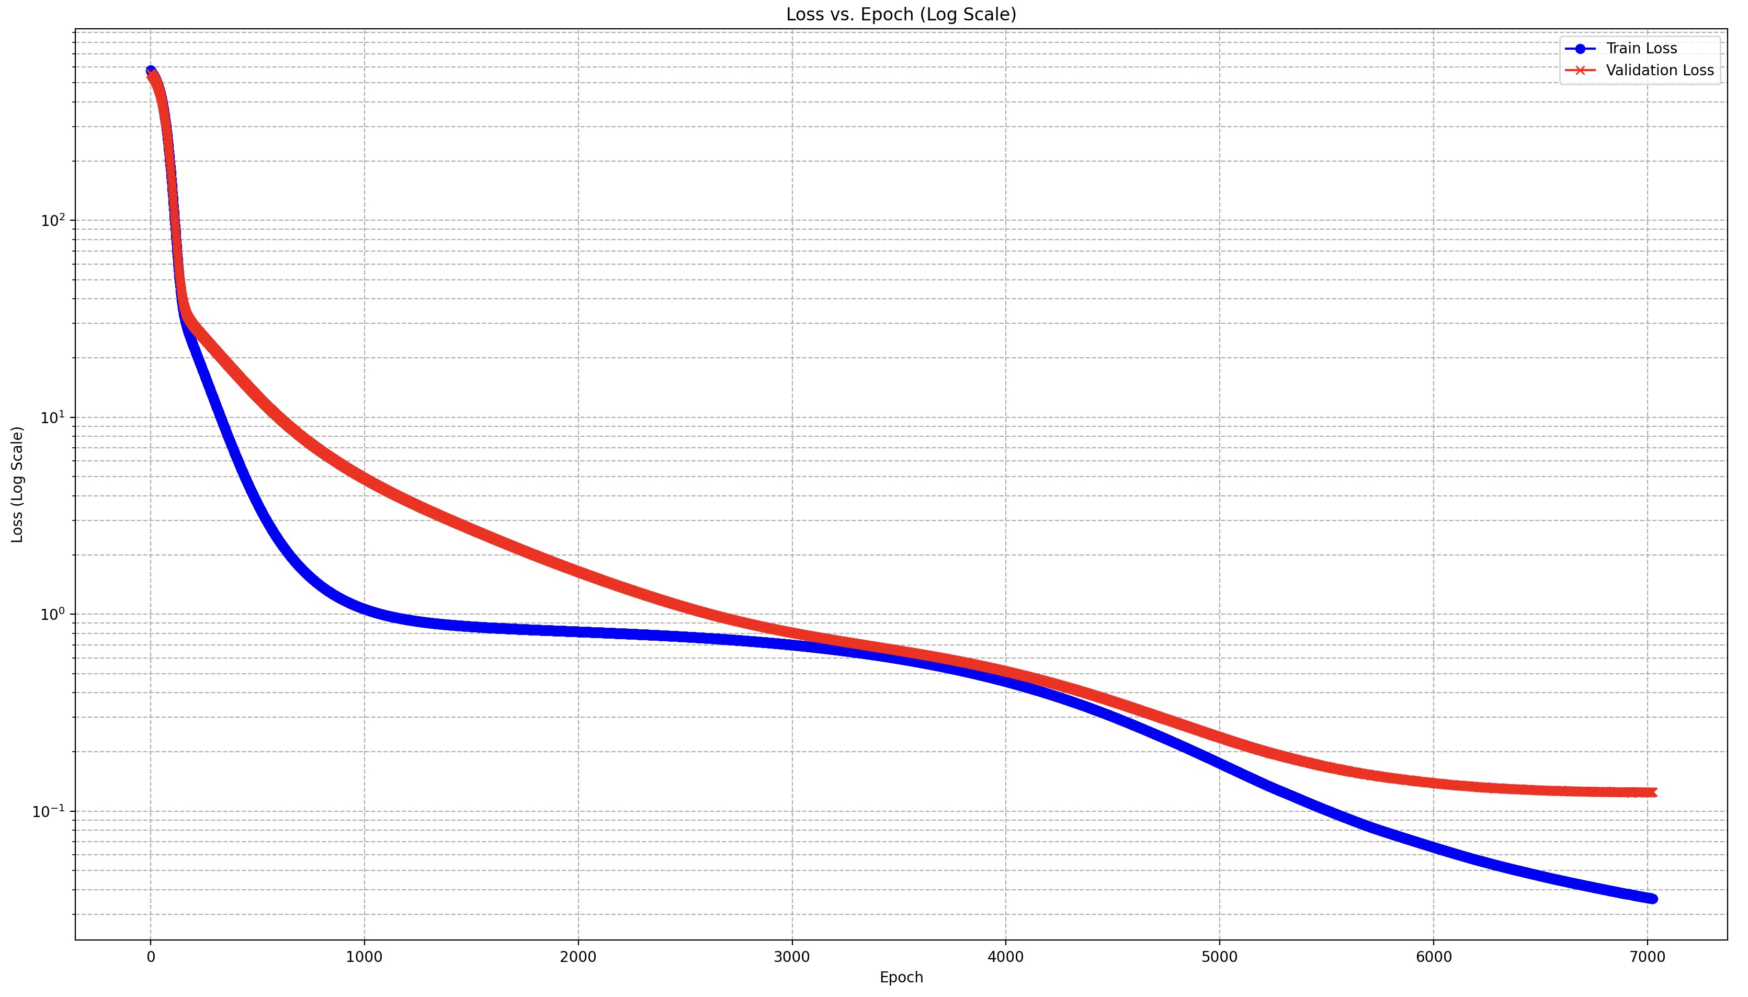
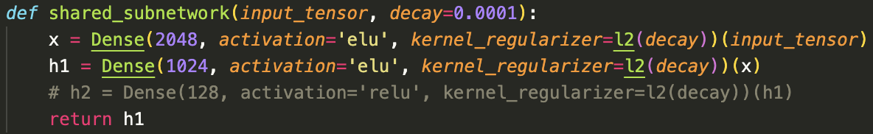
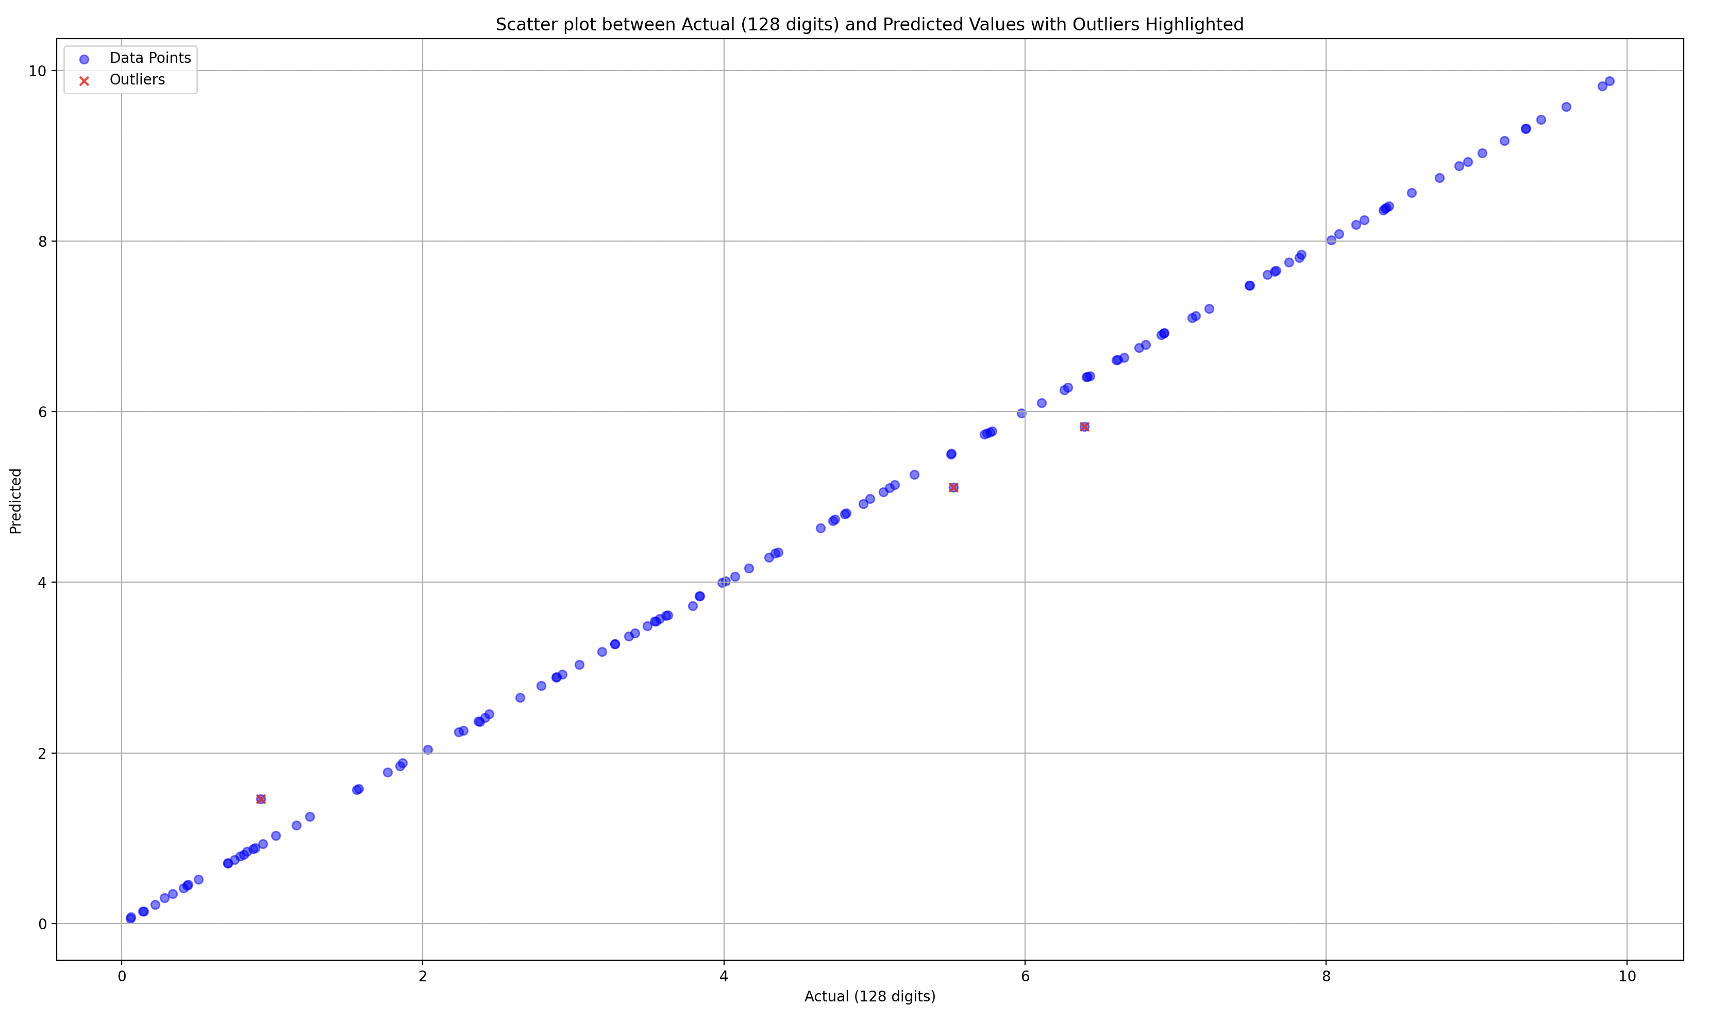
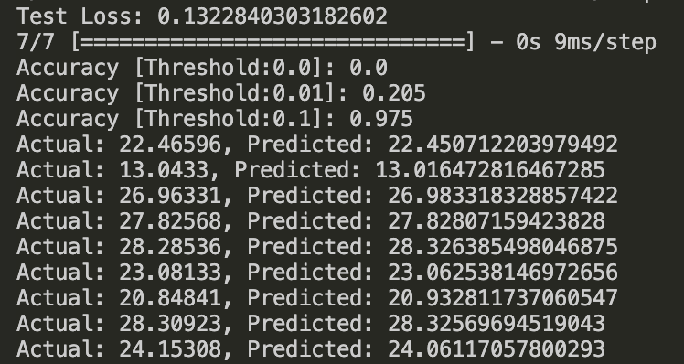
(ELU, ELU)
Outlier -> Actual: 6.39509, Predicted: 5.825188827514649
Outlier -> Actual: 0.92182, Predicted: 1.4583987236022948
Outlier -> Actual: 5.524, Predicted: 5.112775802612305

Slide 5
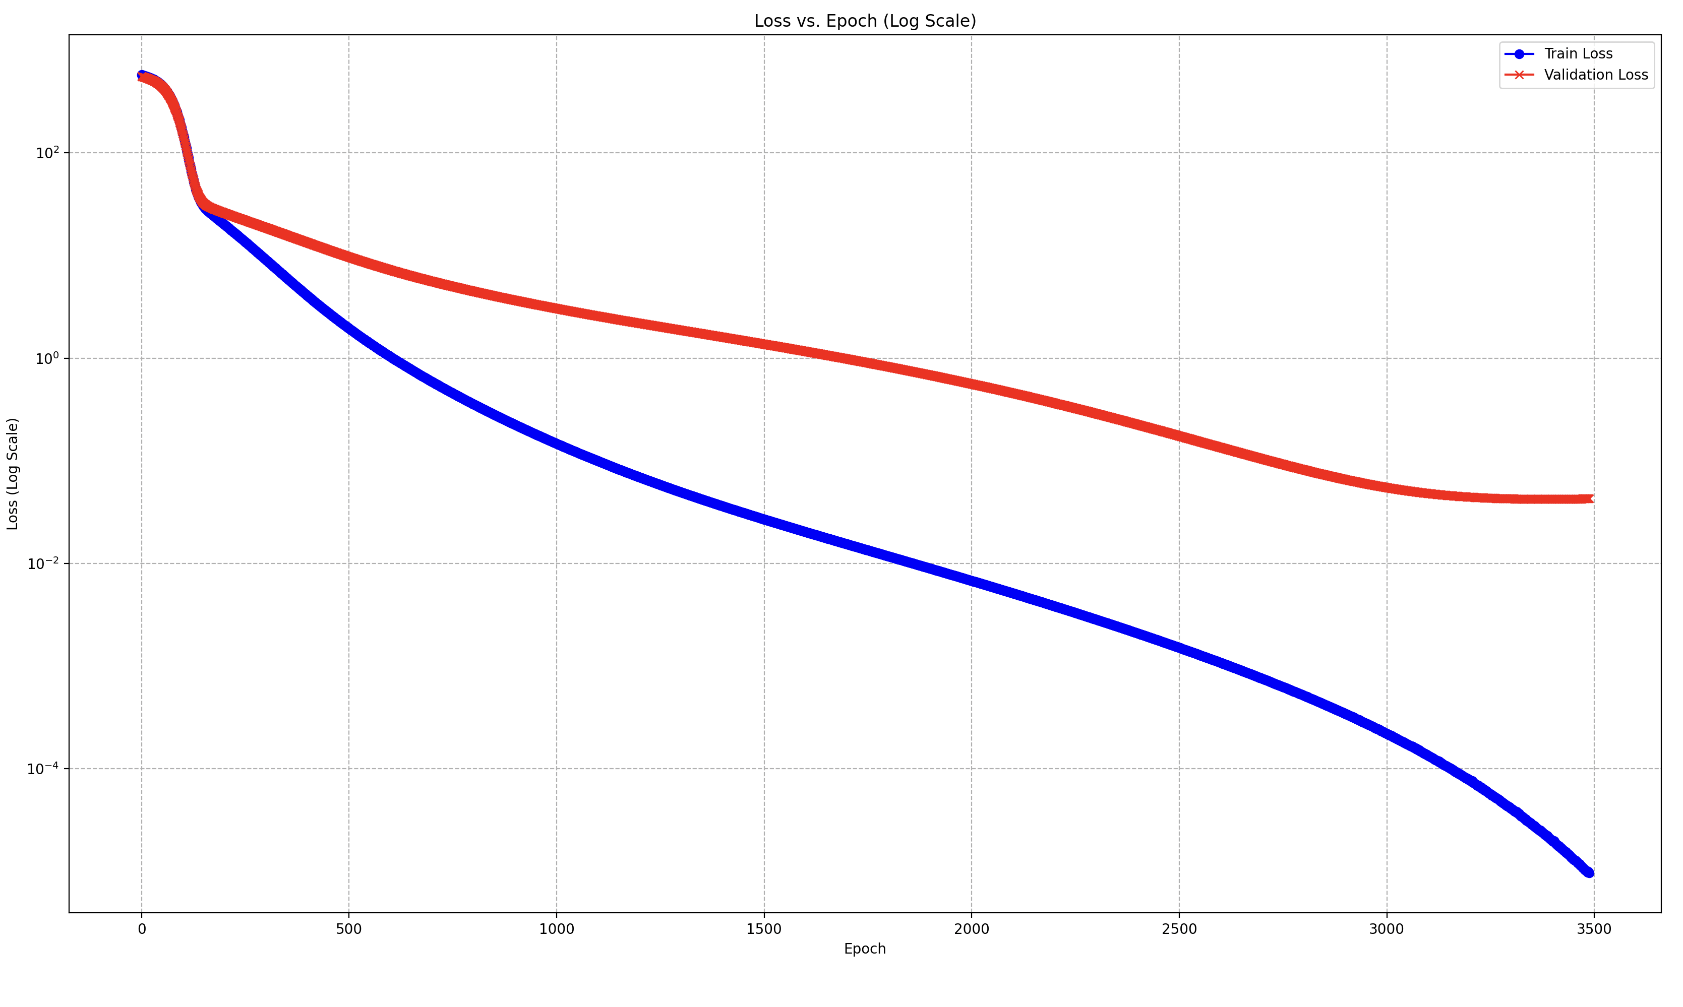
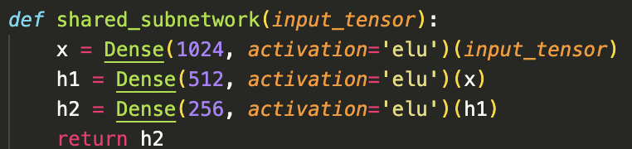
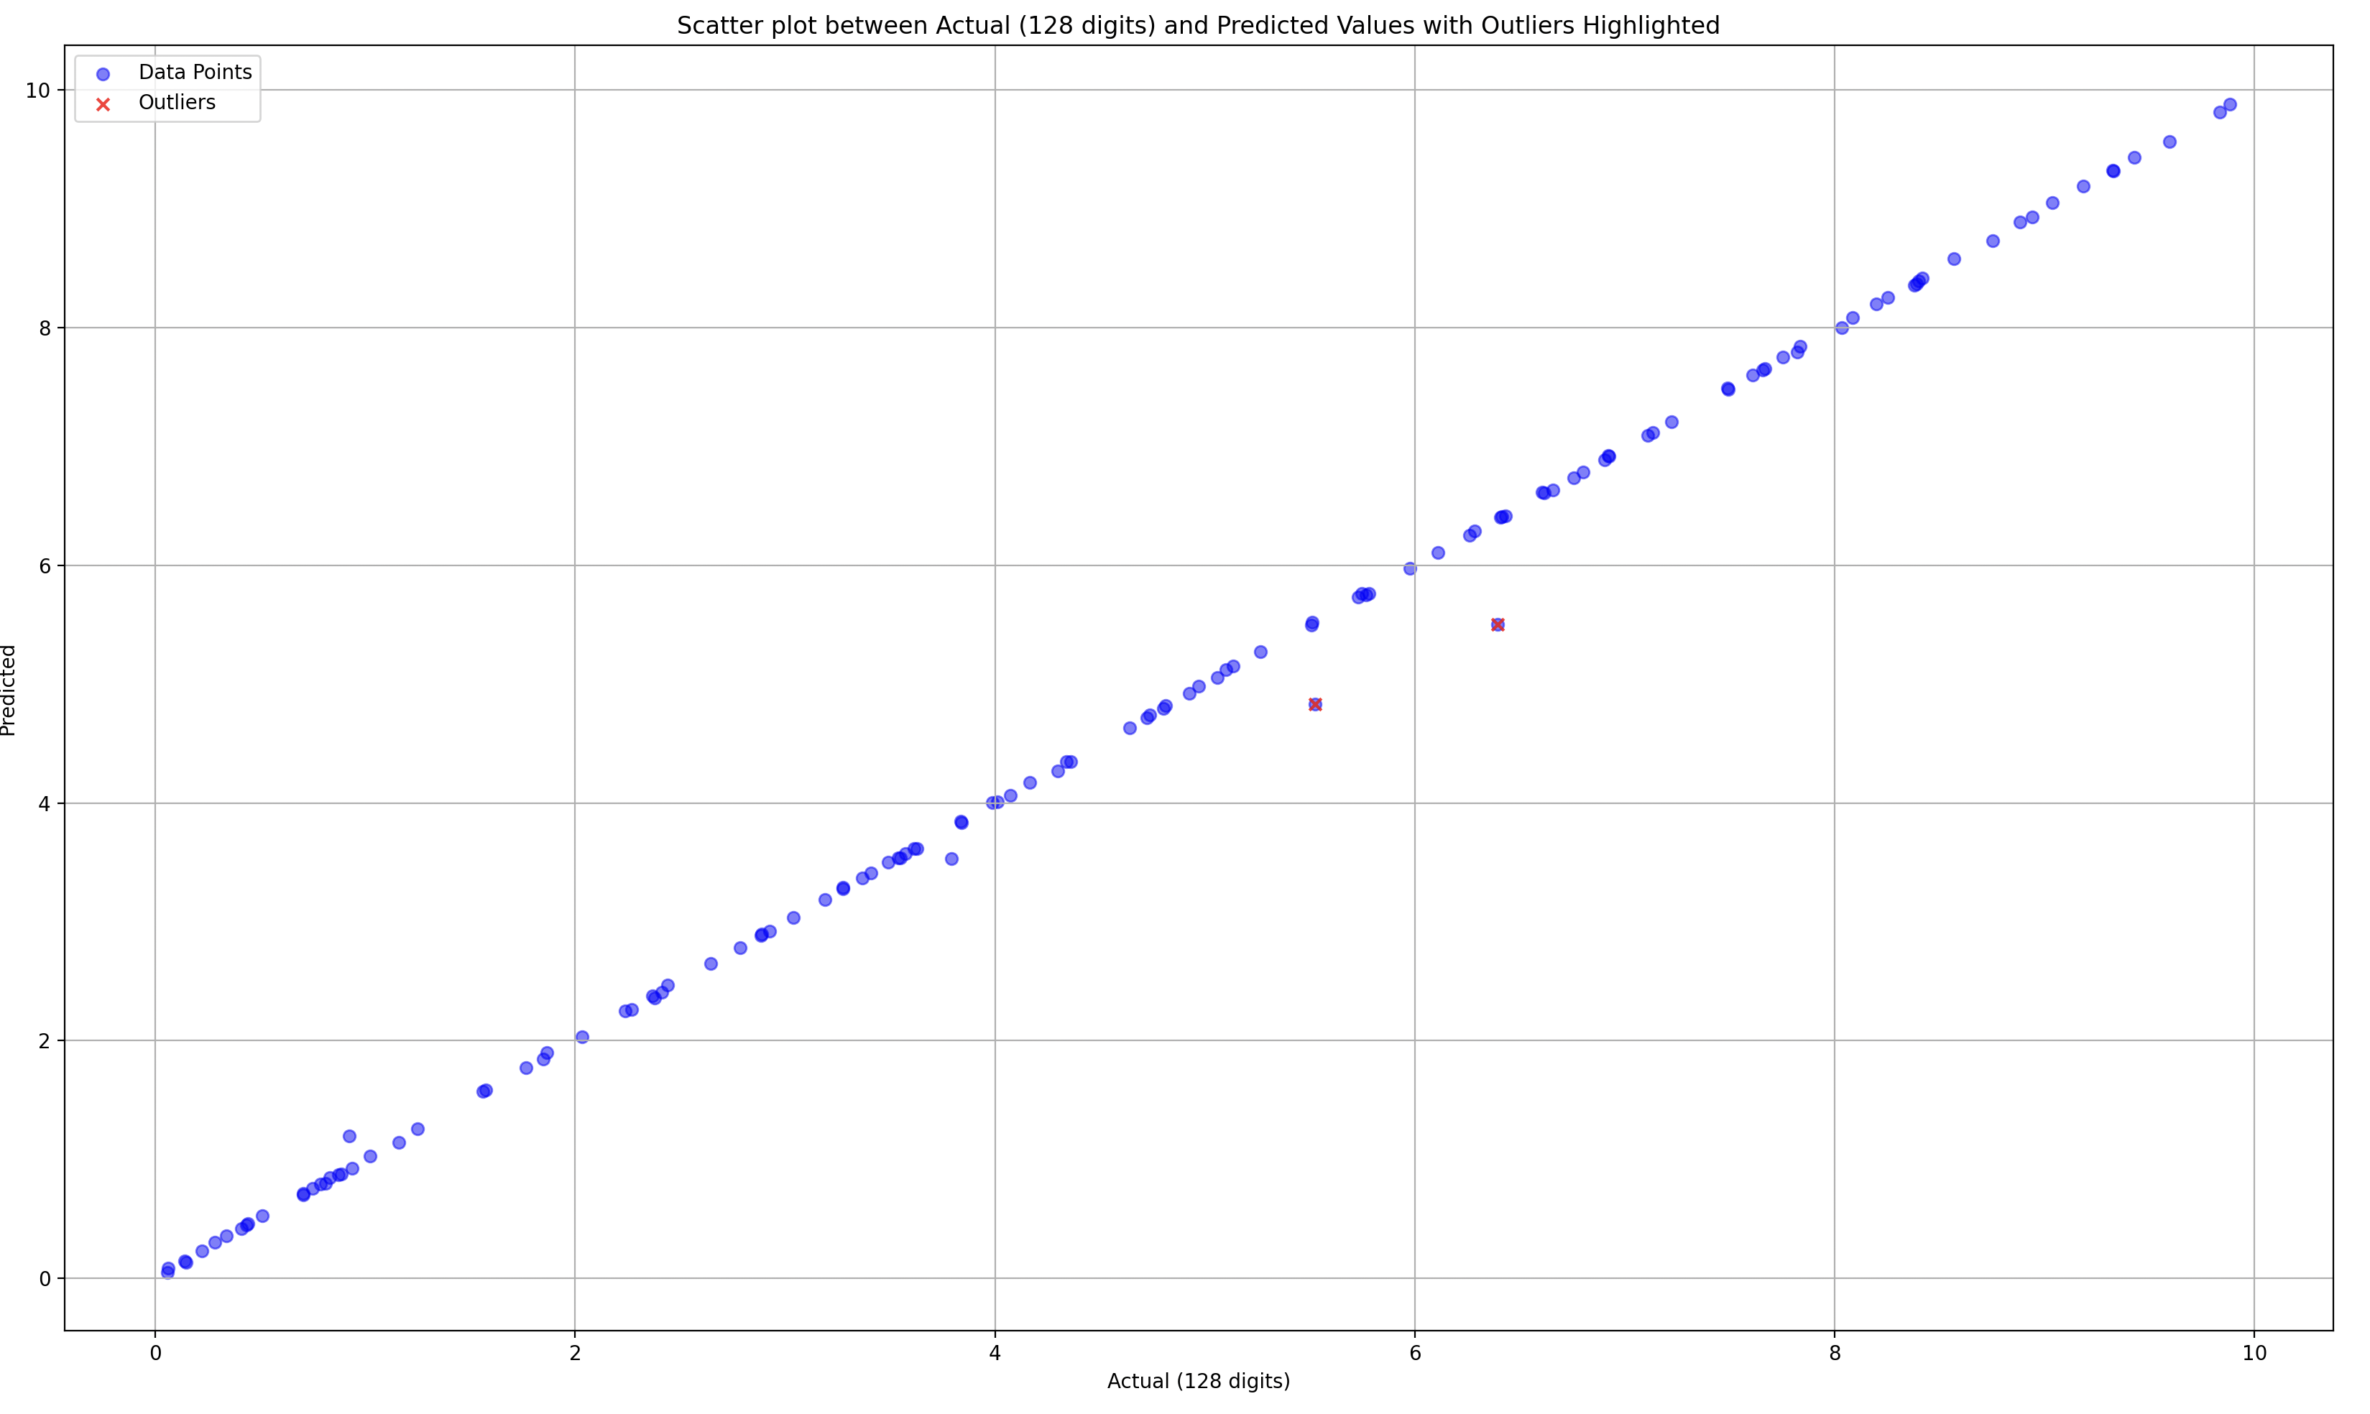
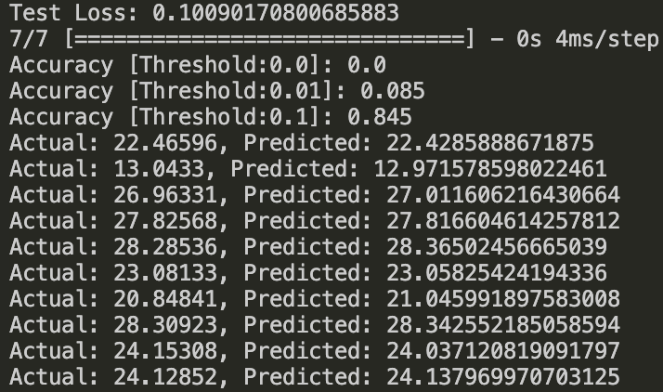
Deeper ELU
Outlier -> Actual: 6.39509, Predicted: 5.500883483886719
Outlier -> Actual: 5.524, Predicted: 4.834860610961914

Slide 6
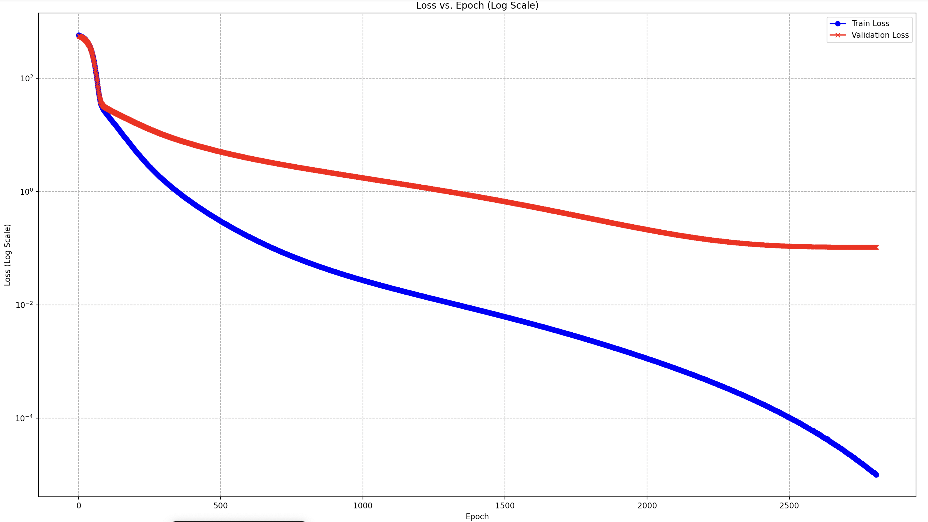
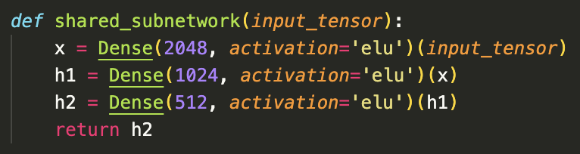
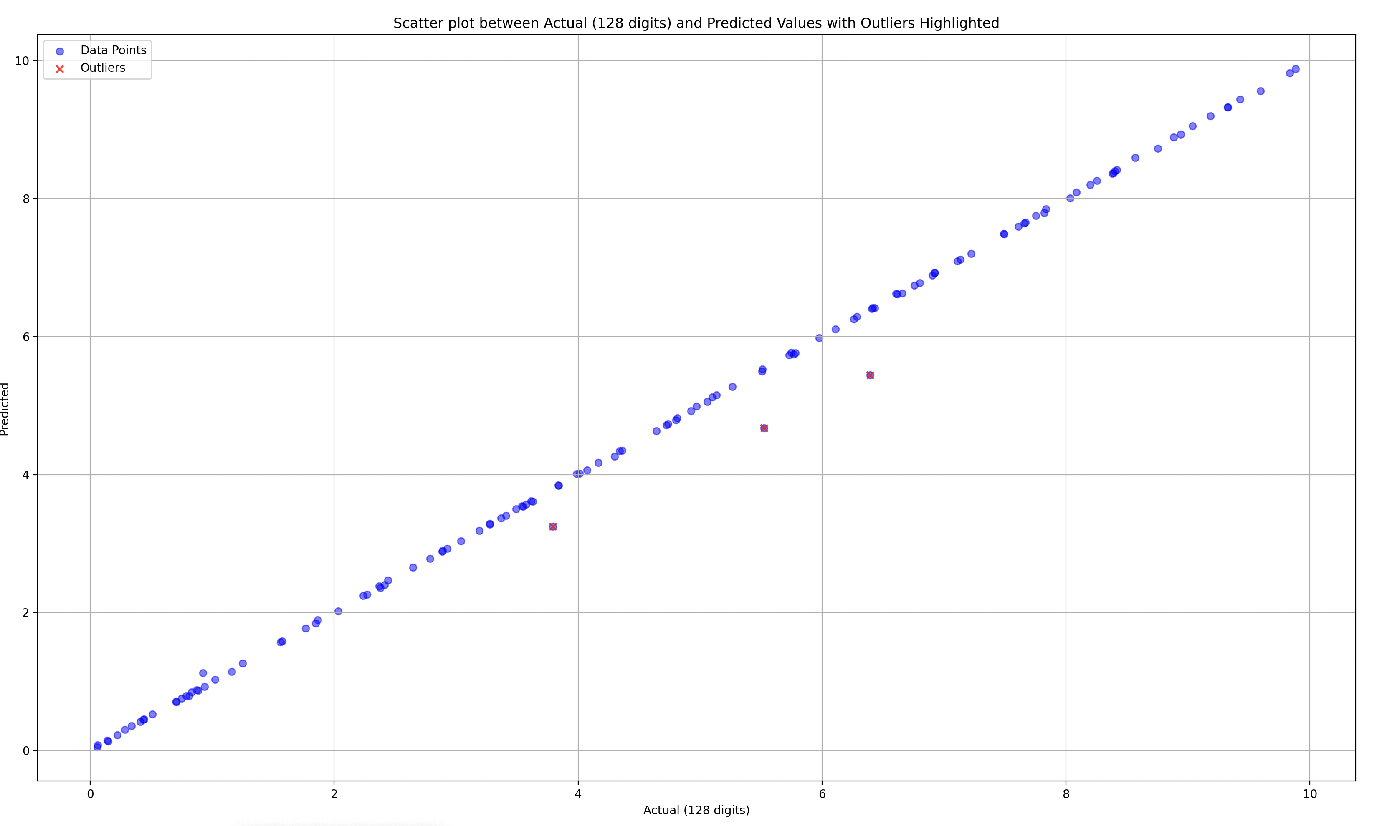
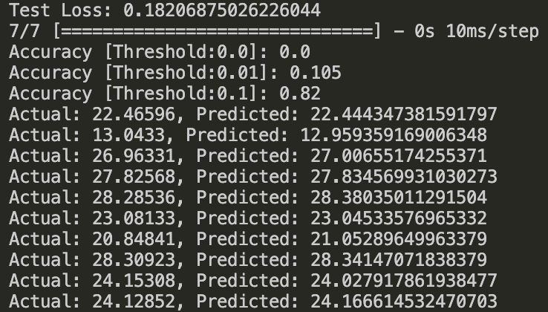
Wider-Deeper ELU
Outlier -> Actual: 6.39509, Predicted: 5.4438629150390625
Outlier -> Actual: 3.79308, Predicted: 3.2461681365966797
Outlier -> Actual: 5.524, Predicted: 4.67175407409668

